Slide 1
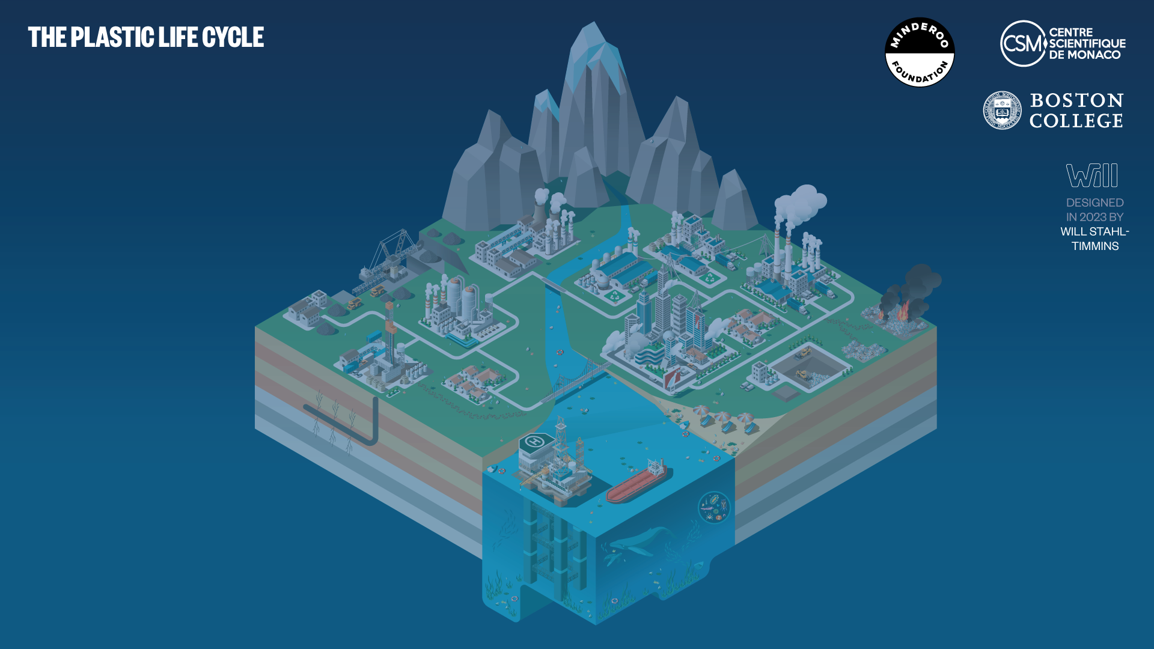
MINDEROO-MONACO COMMISSION ON PLASTICS
AND
HUMAN HEALTH

Slide 2
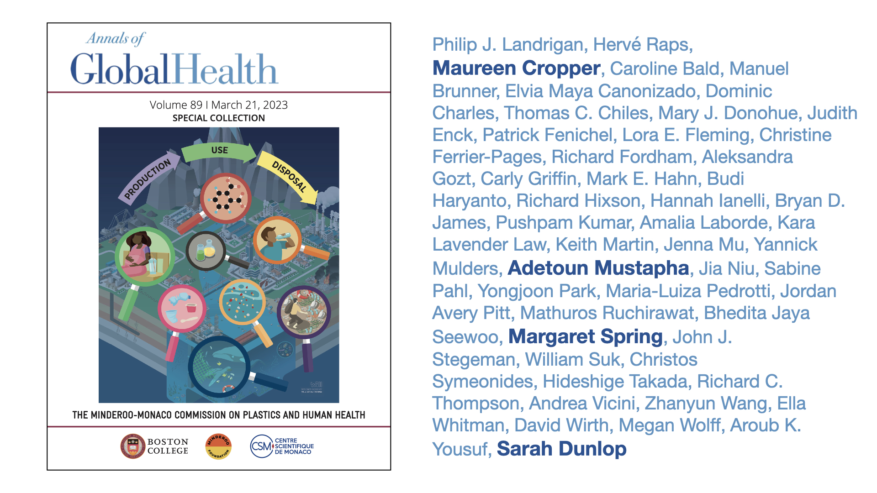
doi: 10.5334/aogh.4056

Slide 3
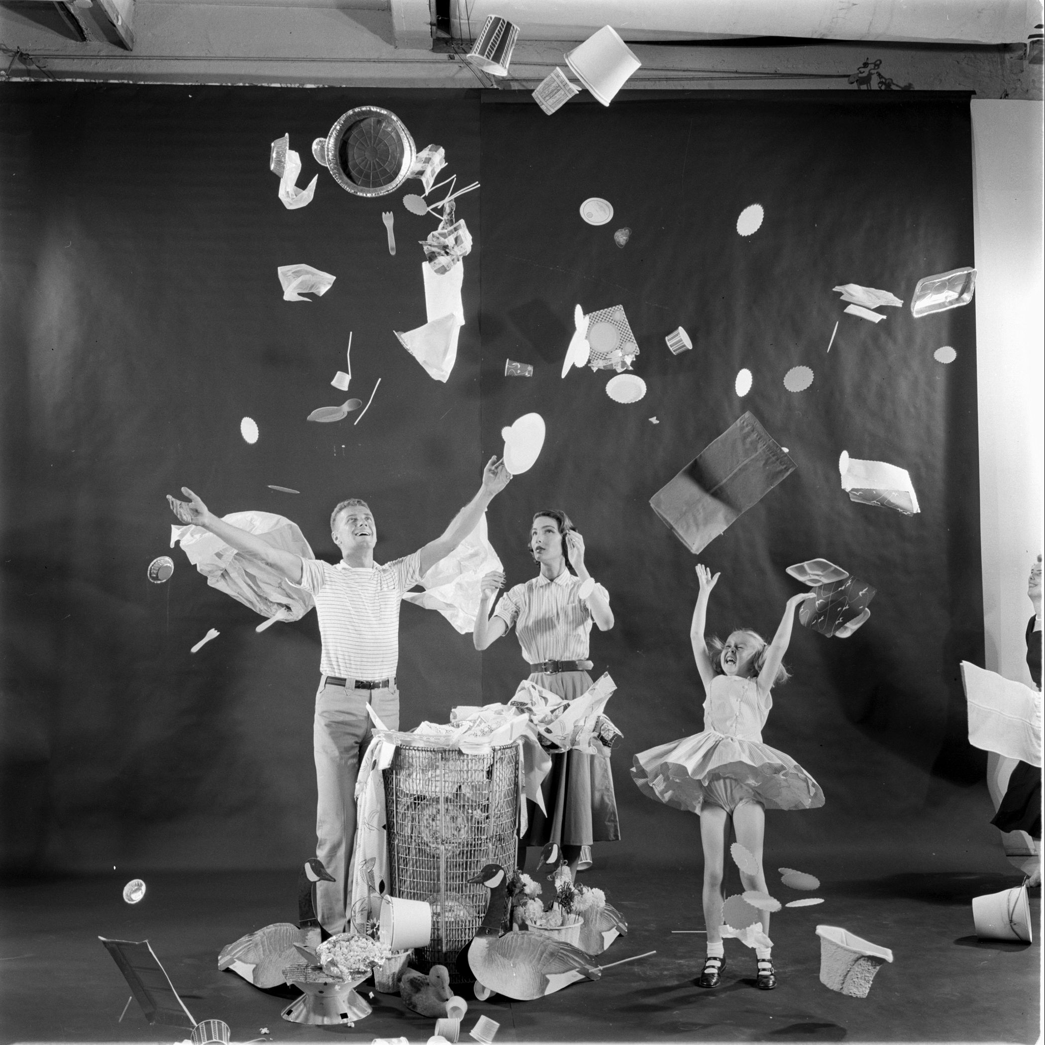
PLASTIC -THE SIGNATURE MATERIAL OF OUR AGE
THE AGE OF DISPOSABLE LIVING

Slide 4
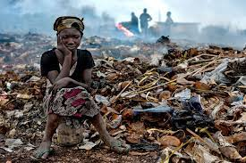
To make the invisible visible
To count plastic's uncounted costs – to human health, the earth’s environment, the global economy, and social justice
To count these previously unseen costs across the entire plastic life cycle
To protect human health, prevent disease, and save lives. Plastic is not just an environmental problem.
MINDEROO MONACO COMMISSION GOALS
Notes:
Plastic. Agbogbloshie e-waste dumpsite, Ghana

Slide 5
PLASTIC PRODUCTION IS INCREASING EXPONENTIALLY
8 trillion metric tons (Gigatons) produced since 1950
98-99% made from fossil
carbon – coal, oil, gas
Production is energy-intensive
-3.7% of greenhouse gas
Emissions. Air pollution.
Production is accelerating. Half of all plastic has been
made since 2002. On track to double again by 2050
35-40% of current production
is single-use plastic
Less than 10% is recycled
6 trillion metric tons
(Gigatons) pollute the global
environment
400 million
metric tons
1.7 million
metric tons

Slide 6
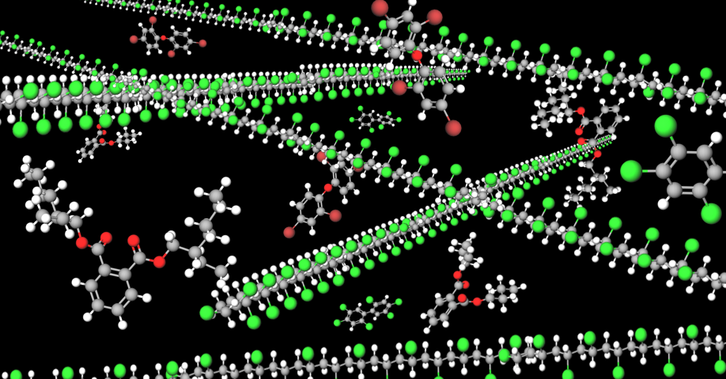
PLASTICS ARE COMPLEX
Polymer backbone
10,500+ added chemicals
Plasticizers
Flame retardants
UV stabilizers
Antioxidants
Processing aids
  Catalysts
  Solvents
Unreacted monomers
Non-intentionally added substances (NIAS)
Additives include carcinogens, neurotoxicants, endocrine disruptors
Most additives have never been tested for toxicity
Chemicals leach out of plastics to enter the environment and to enter people

Slide 7
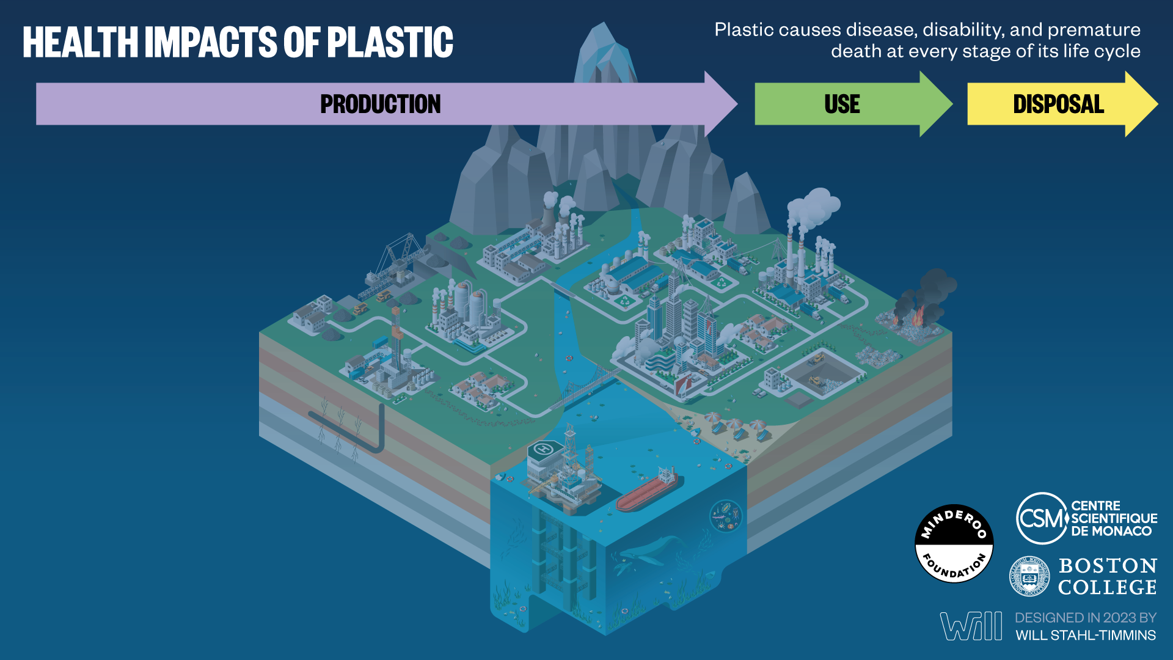
PLASTICS’ HAZARDS TO HUMAN HEALTH
ARE MUCH MORE THAN
BEACH LITTER AND MICROPLASTICS

Slide 8
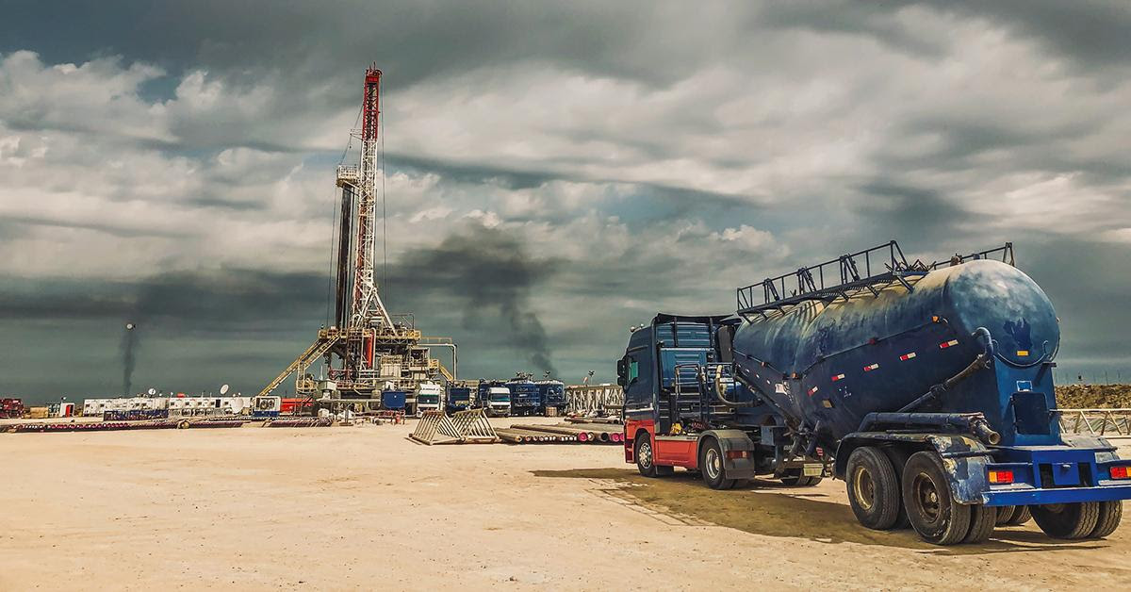
HEALTH IMPACTS OF PLASTIC PRODUCTION
OCCUPATIONAL HAZARDS TO FRACKING WORKERS
& FENCELINE COMMUNITIES

Slide 9
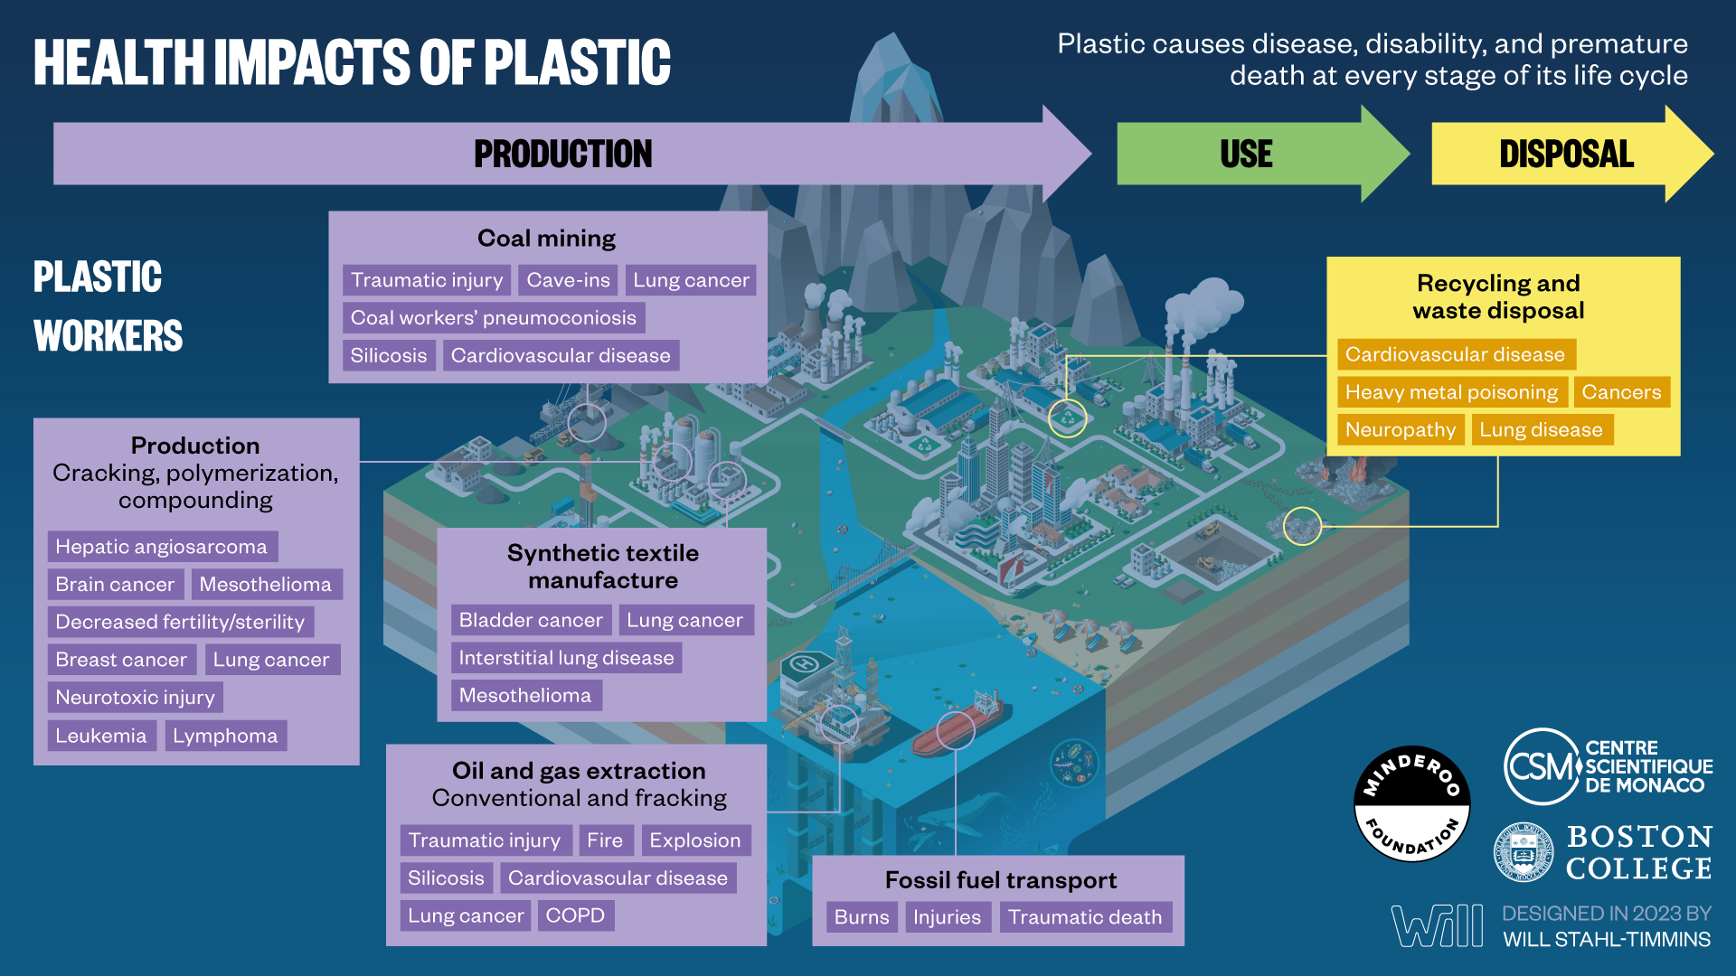

Slide 10
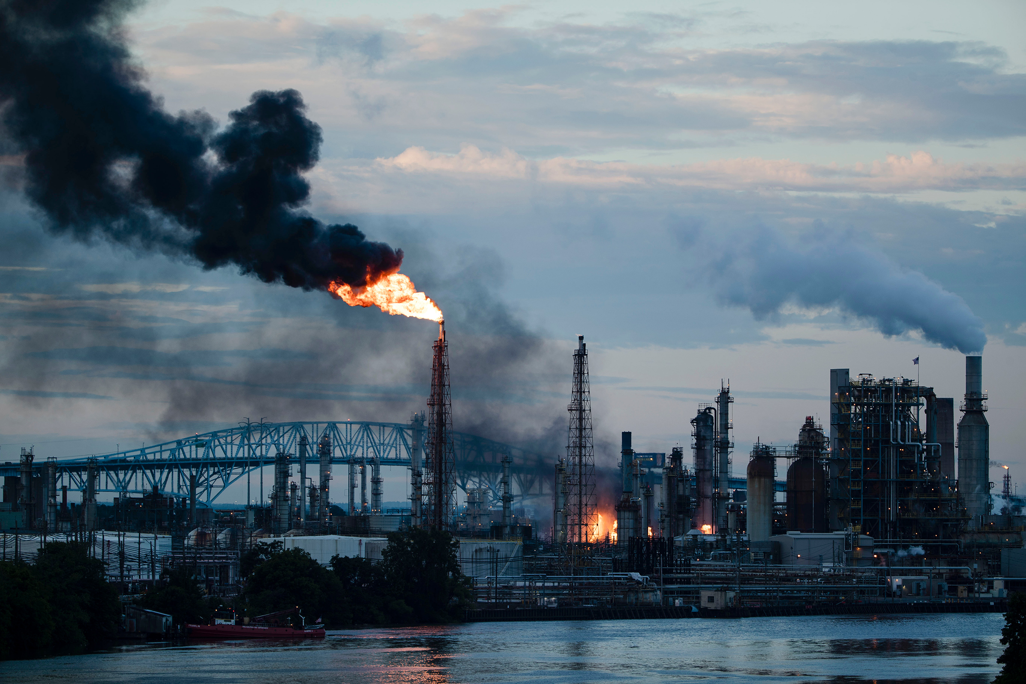
HEALTH IMPACTS OF PLASTIC PRODUCTION
OCCUPATIONAL HAZARDS TO PETROCHEMICAL WORKERS
& FENCELINE COMMUNITIES

Slide 11
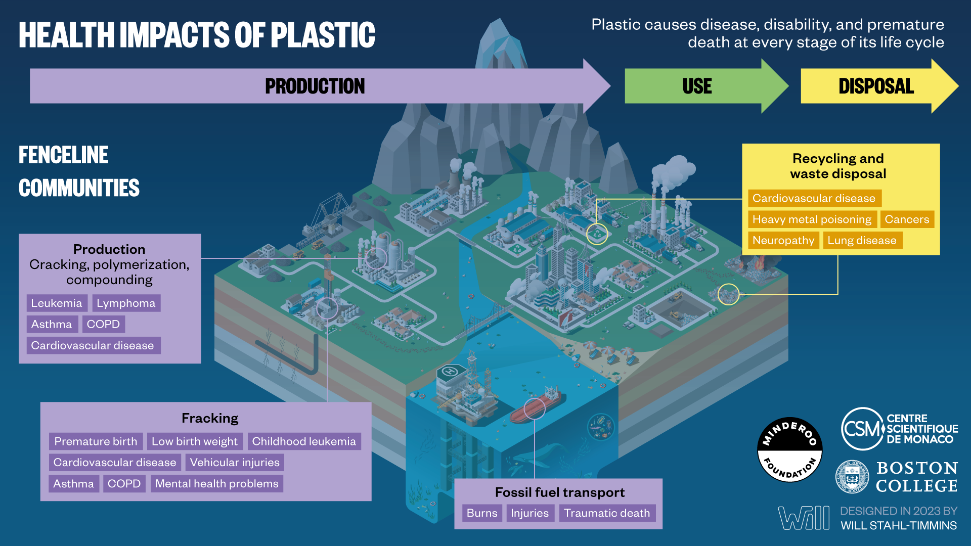

Slide 12

HEALTH IMPACTS OF PLASTIC PRODUCTION
HAZARDS TO
PLASTIC USERS

Slide 13
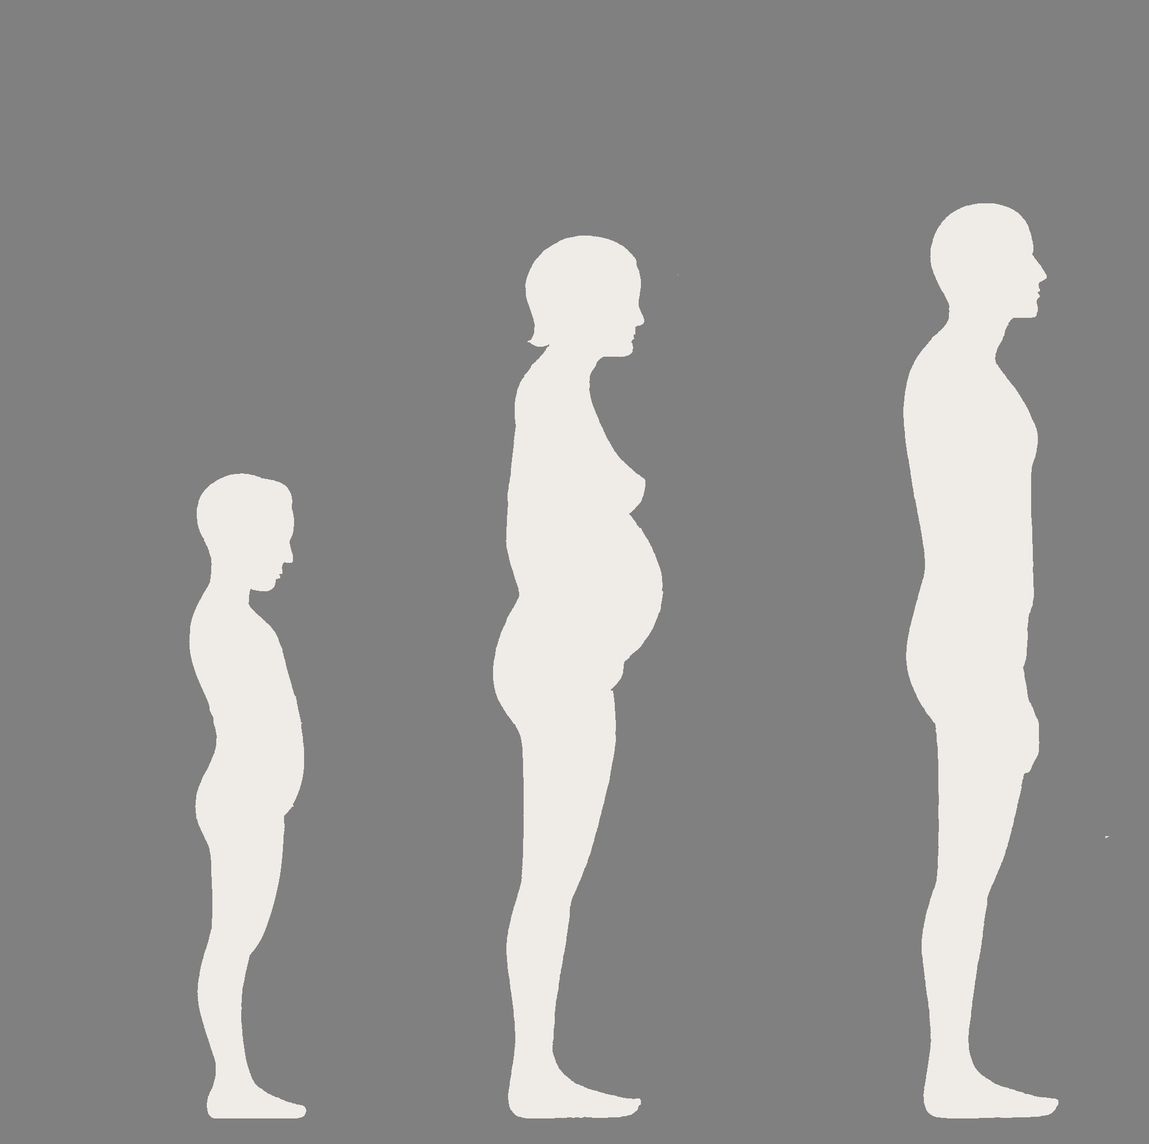


HEALTH IMPACTS
EVERYDAY EXPOSURE
Plastic chemicals:
Bisphenol-A
Phthalates
Flame retardants
PFAS
Micro- & nanoplastics?
IQ loss
Hypertension/
Cardiovascular
disease
Altered thyroid function
Decreased cognitive development
Breast cancer
Obesity
Miscarriage
Impaired fine motor development
Hypertension
Insulin resistance/ Type 2 diabetes
Obesity
Liver cancer
Decreased birth weight
Decreased sperm concentration & quality
Changed pubertal timing
Endometriosis
Shortened Anogenital
distance
Polycystic ovary syndrome

Slide 14

INFANTS IN THE WOMB AND YOUNG CHILDREN ARE
EXQUISITELY VULNERABLE TO PLASTIC CHEMICALS
Toxic chemicals in plastic can cause damage to infants and children at even the lowest levels detectable – levels far below those that harm adults
Prenatal exposure in the womb during pregnancy is especially dangerous
Plastic chemicals can cause brain damage, birth defects and cancer.
The brain damage caused by plastic chemicals can result in autism, ADHD and decreased intelligence (IQ loss)
There are no safe exposure “thresholds” in prenatal life
These effects can last lifelong
Exposure prevention is the only effective treatment

Slide 15
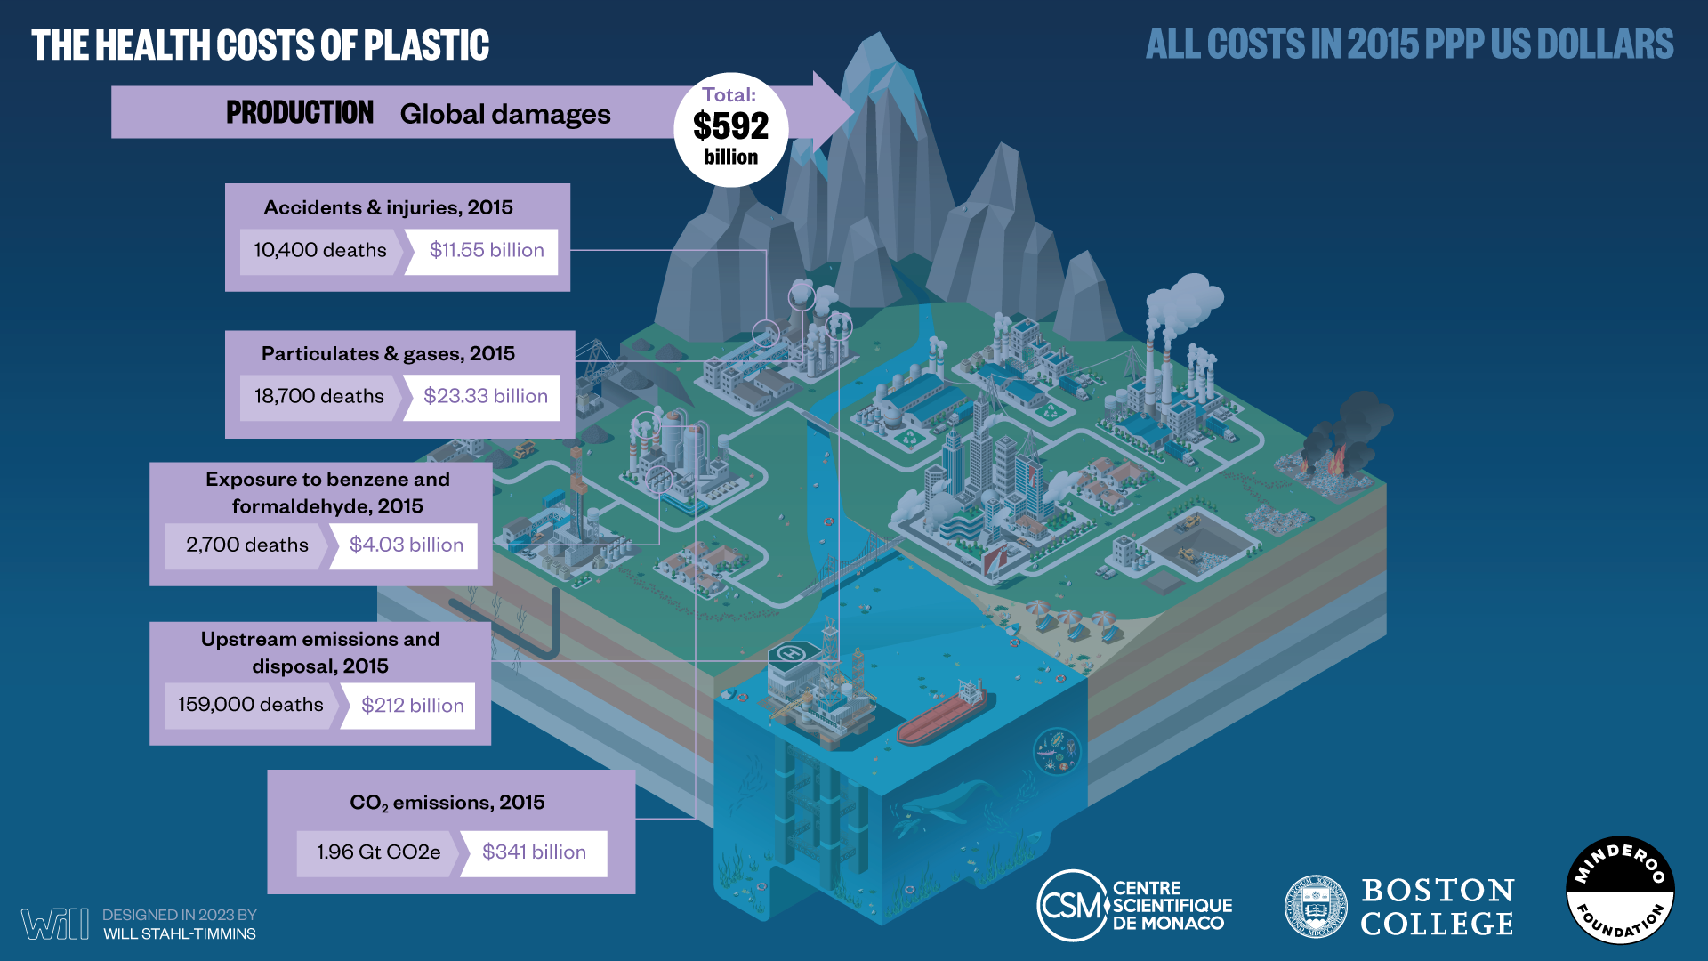

Slide 16
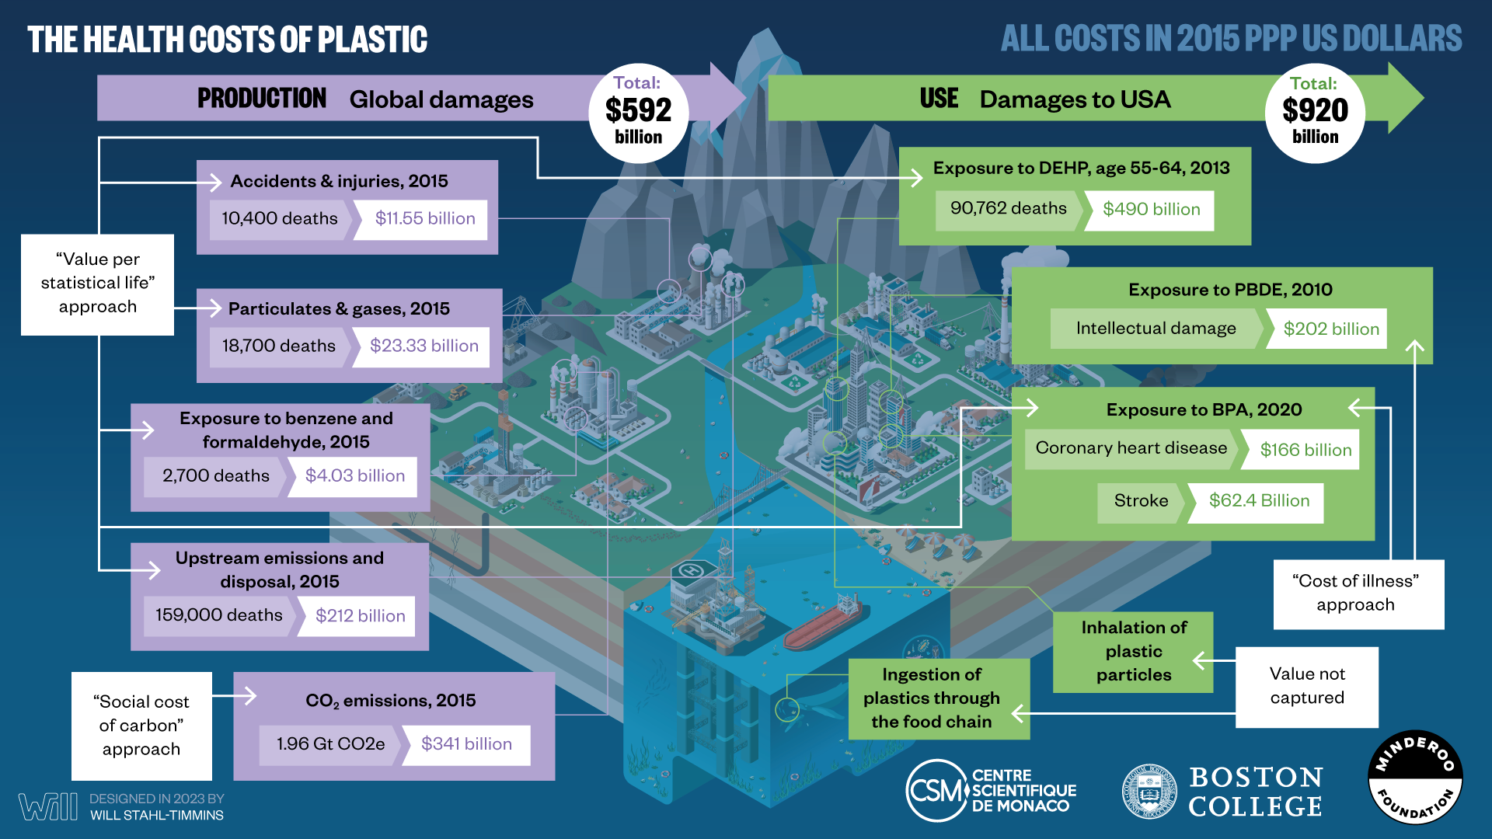

Slide 17
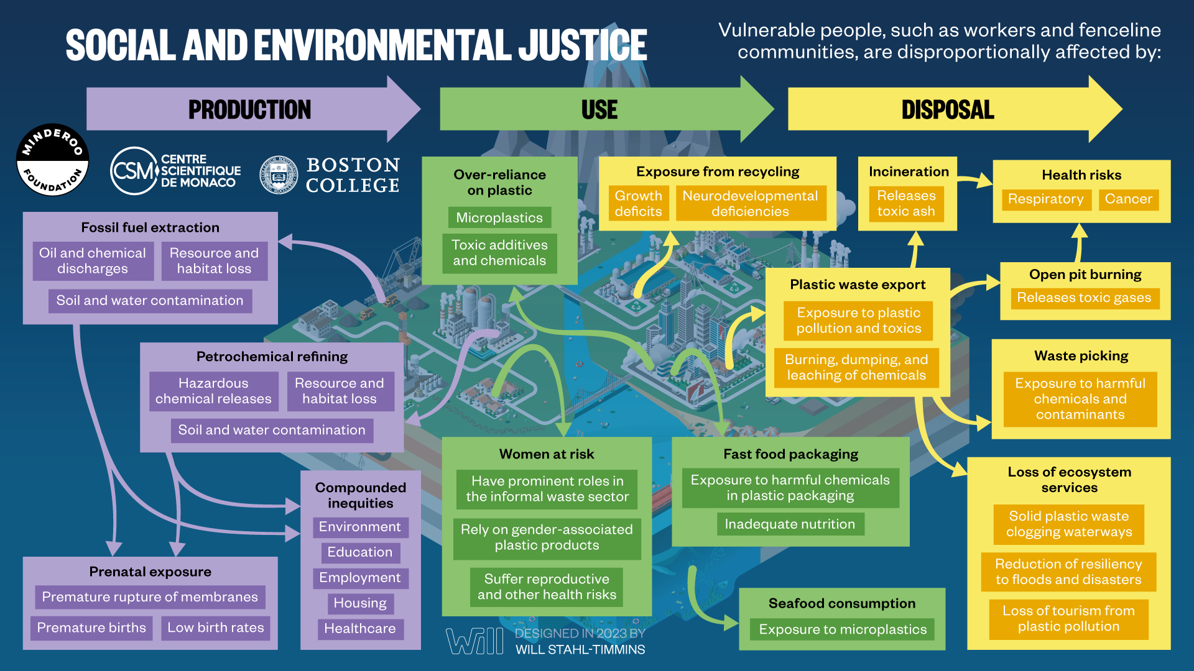
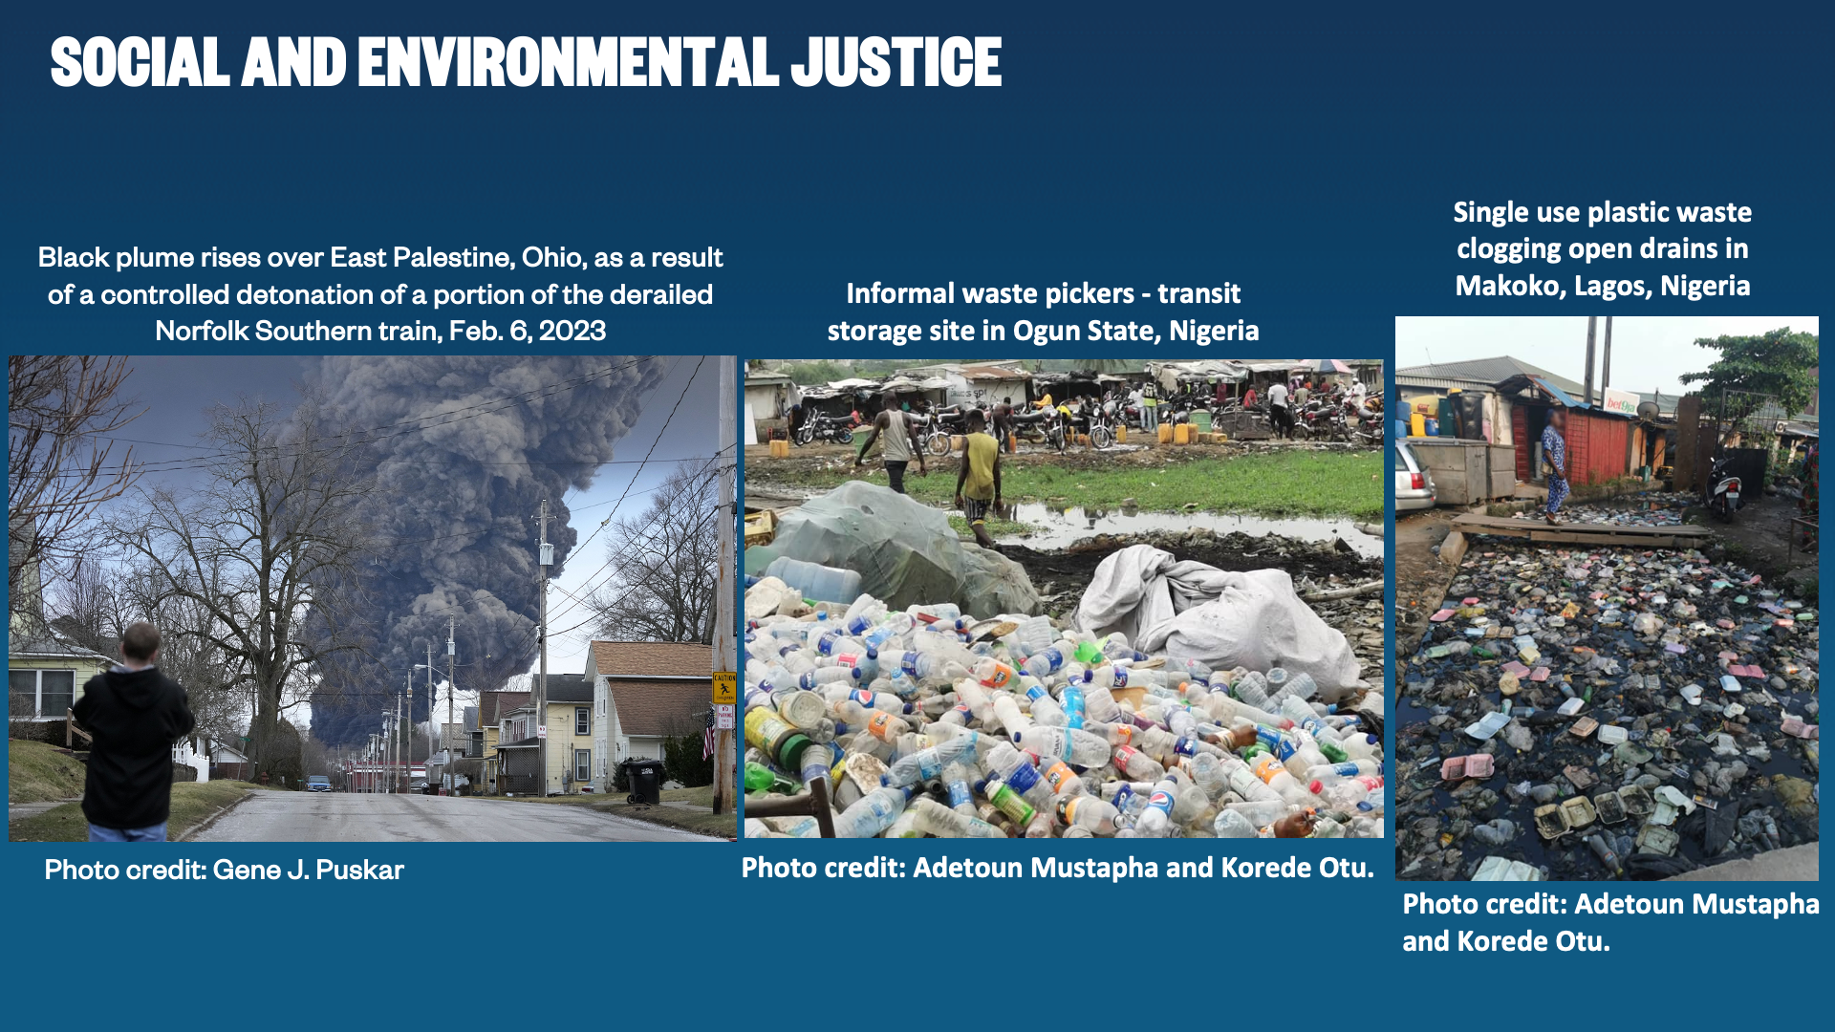

Slide 19
THE TIME HAS COME WHEN WE MUST ACT
There is much about plastic and its hazards that we still do not know, and more research is needed
But we now know very clearly that plastics’ harms to human health and the global environment are extremely serious.
And we know that in the absence of urgent intervention these harms will get much worse.
We cannot use lack of complete knowledge about plastics’ harms as an excuse for inaction.

Slide 20
COMMISSION KEY RECOMMENDATIONS
Our strongest recommendation is that the world’s nations must urgently develop and implement a strong, comprehensive, and legally binding Global Plastics Treaty, pursuant to the resolution of the 2022 United Nations Environment Assembly (UNEA)

Slide 21
COMMISSION KEY RECOMMENDATIONS
Protection of human health, end especially the health of vulnerable and at-risk populations, must be an over-arching goal of the Global Plastic Treaty. Plastic is not just an environmental problem.
A global cap on plastic production needs to be a key component of the Global Plastic Treaty. The great power of a global cap is that it will reduce the volume of plastics and plastic waste at its root source. Implementation of this cap needs to be guided by targets and timetables and supported by national commitments.

Slide 22
COMMISSION SPECIFIC RECOMMENDATIONS
The Treaty needs to ban or severely restrict manufacture of unnecessary, single-use plastics
The Treaty needs to include plastic-associated chemicals and all plastic additives – not only polymers. Set health-protective standards. Require pre-market testing. Reduce chemical complexity. Increase transparency.
The Treaty needs to mandate Extended Producer Responsibility (EPR) for all plastic products
The Treaty needs to explore listing some plastic polymers and plastic-associated chemicals as POPs under the Stockholm Convention
The Treaty needs to address the disproportionate impacts of plastics on vulnerable and at-risk populations
The Treaty needs to strengthen restrictions on transnational export of plastic waste through interface with the Basel and London Conventions
Treaty implementation will require establishment of a Permanent Science Policy Advisory Body

Slide 23
THE GOOD NEWS
We can fix the plastics’ crisis.
We know how to do it
In high-income and some mid-income countries, we have controlled air and water pollution – and done so cost-effectively –through laws, regulations, monitoring, enforcement and incentives
This experience provides a roadmap and toolkit for addressing the global plastics crisis
The impediments to controlling the plastics’ crisis are not technical
They are legal, economic, and political
It is our generation’s moral and ethical duty to overcome these impediments and to act courageously to
protect our children’s health
and
preserve our Common Home

Slide 24

THANK YOU

